Slide 1

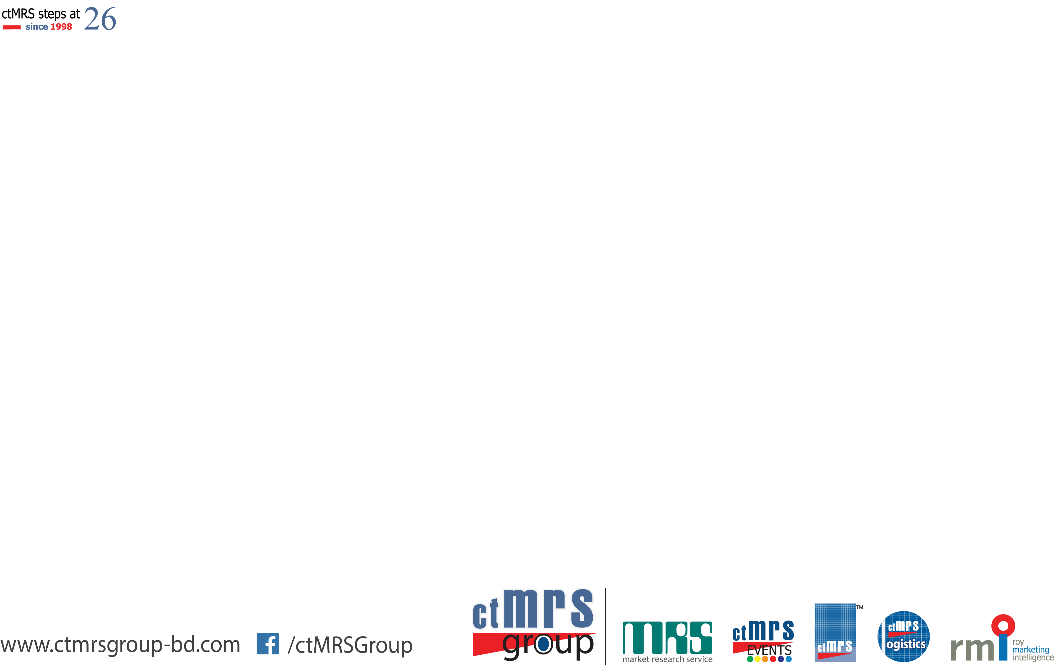

Credentials of MRS

Slide 2
About MRS
Market Research Service (MRS), a subsidiary of the ctMRS Group—one of Bangladesh’s foremost survey research organizations—specializes in executing multi-country research assignments on behalf of prominent global research agencies and end clients. MRS has also established a significant presence in the domestic market, offering comprehensive market and social research solutions, supported by a highly skilled team of full-time and part-time professionals with extensive nationwide coverage.
Over the years, MRS has garnered a reputation for excellence within the research community by adhering strictly to the guidelines of ICC/ESOMAR and ensuring the highest standards of quality in its deliverables.
Since its inception in 2006, with headquarters in Lalmatia, Dhaka, MRS has developed a robust fieldwork infrastructure comprising well-trained and experienced interviewers operating across both urban and rural regions of Bangladesh. Consequently, an increasing number of domestic and international enterprises are entrusting MRS with their research requirements across this region.

Slide 3
Our Services
Qualitative Research
Quantitative Research
Data Analysis and Report Writing

Slide 4
Data Collection Tools
Quantitative Data collection tools
Face to face
Telephonic
Online
Mail
Qualitative Data collection tools
Focus group
In Depth Interviews
Online Communities
Online forums

Slide 5

Important Projects….

Slide 6
Covered 8 divisions in Bangladesh
Washing machine, Laundry Liquid , Laundry bar, Detergent powder
7 days Diary placement
1000
Respondents
Laundry L & R 2026
Acknowledging
Laundry habit of
women
Random and
Booster
Sampling

Slide 7
Dhaka, Khulna, Rajshahi & CTG
How to wash dishes, what type of dishwasher mostly used
Dishwash Liquid, Bar and Proxy (Ash, mud) User
400
Respondents
Dishwash L & R 2026
18 to 49 aged
female
respondents
Random
Sampling

Slide 8
500 starting points across the country
To launch a new variant of lux
7 days gap/6 locations
10,000
Respondents
Lux White Bar Product Test
18 to 49 aged
female
respondents
Random and
Booster
Sampling

Slide 9
200 starting points across the country
To launch a new variant of wheel powder
14 days gap/2 locations
7000
Respondents
conducted 3
times
Altair (Wheel Powder) Blind Product Test
18 to 49 aged
female
respondents
Random and
Booster
Sampling

Slide 10
300 starting points across the country
To launch a new variant of Lifebouy Soap
7 days gap/2 locations
9000
Respondents
conducted 3
times
Columbus (Lifebouy Soap) Product Test
18 to 49 aged
female
respondents
Random and
Booster
Sampling

Slide 11
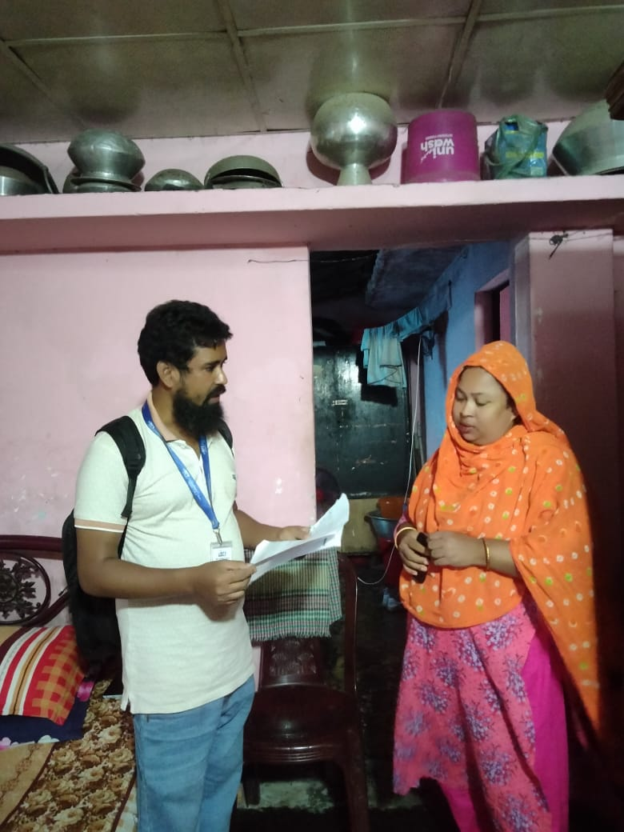
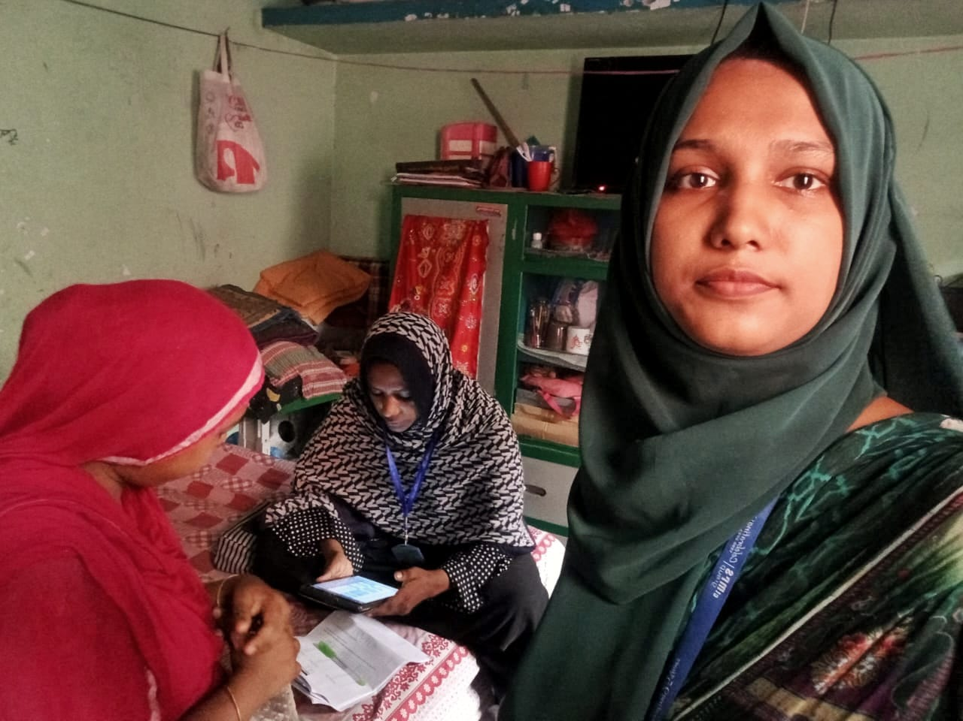
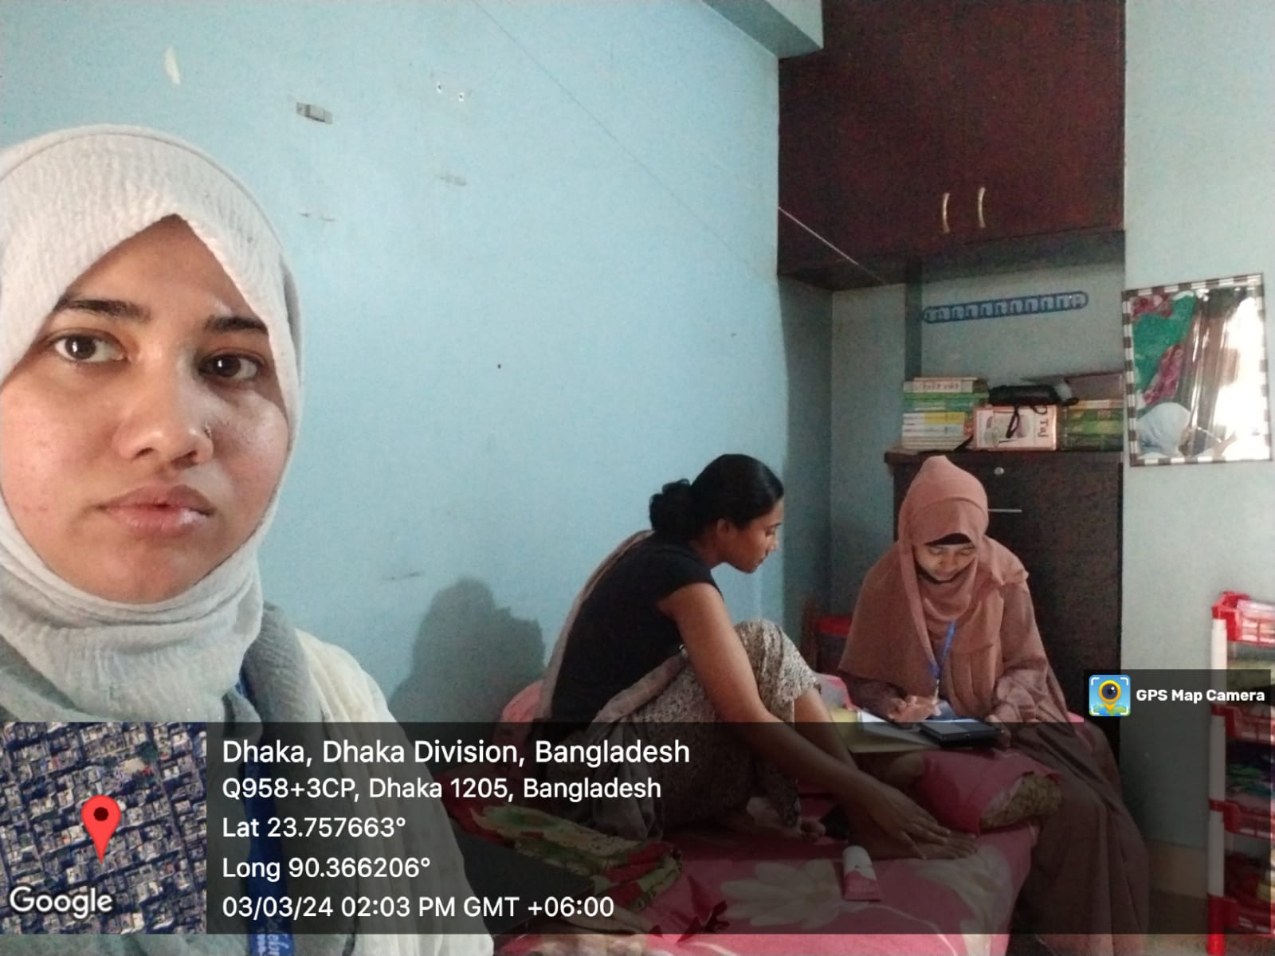
Vim Study
1. Sample size is 7500 and conducted for 2 times
2. Quality checking of dishwash bar and liquid bar
Toothpaste Study (Hailee Cup)
1. Sample size was 5000 and conducted for two times
2. Objective is to launch new variant of close up toothpaste
3. Dhaka, Chittagong and Rajshahi were center
Glow & Lovely Study
1. Sample size was around 1480 and conducted for two times
2. Objective is to launch new variant of Fair & Lovely Fairness Cream

Slide 12
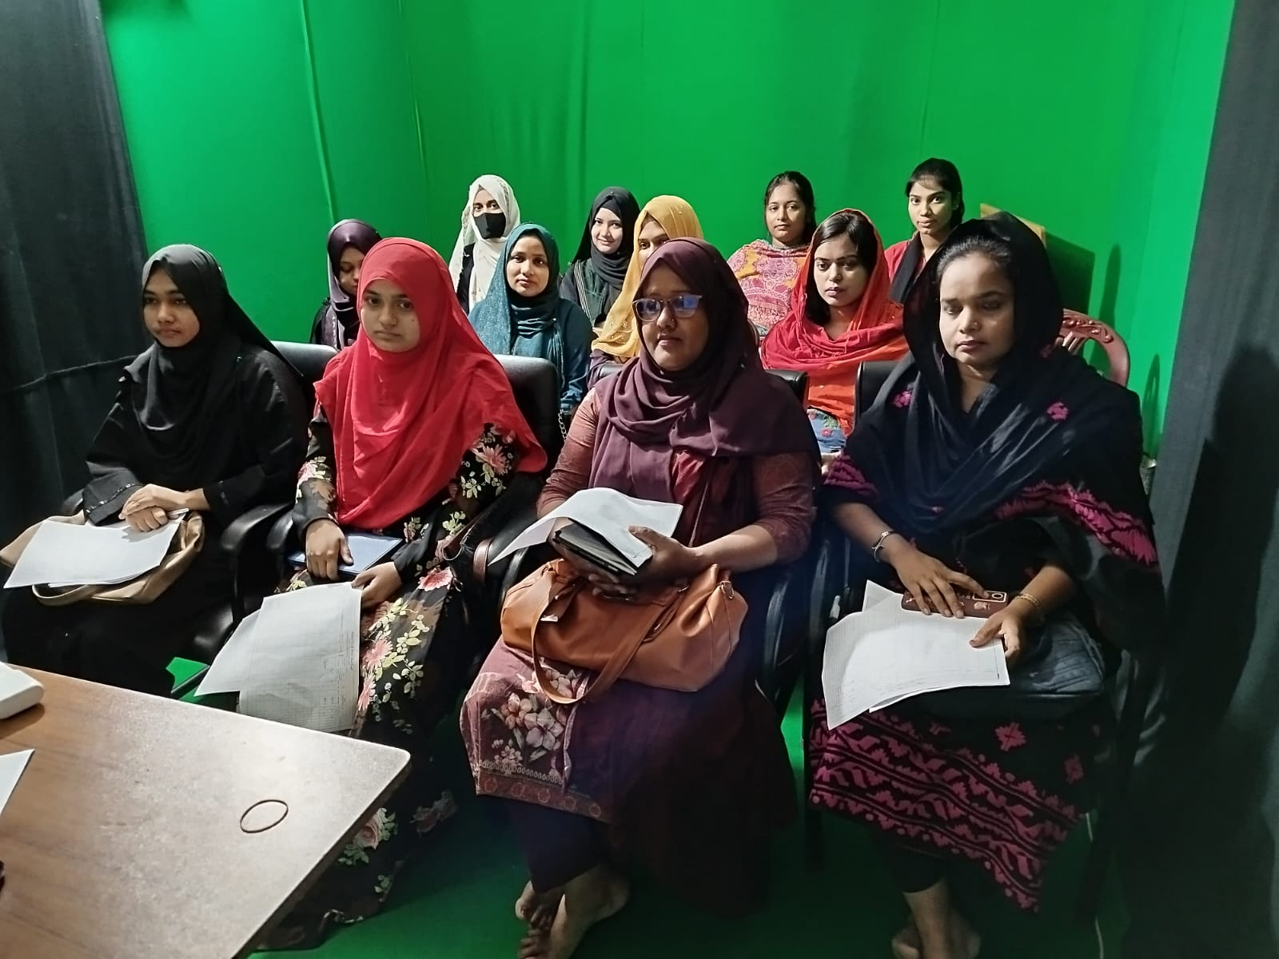
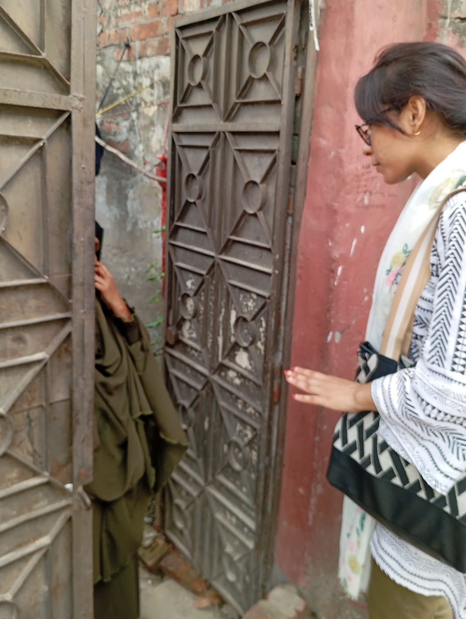
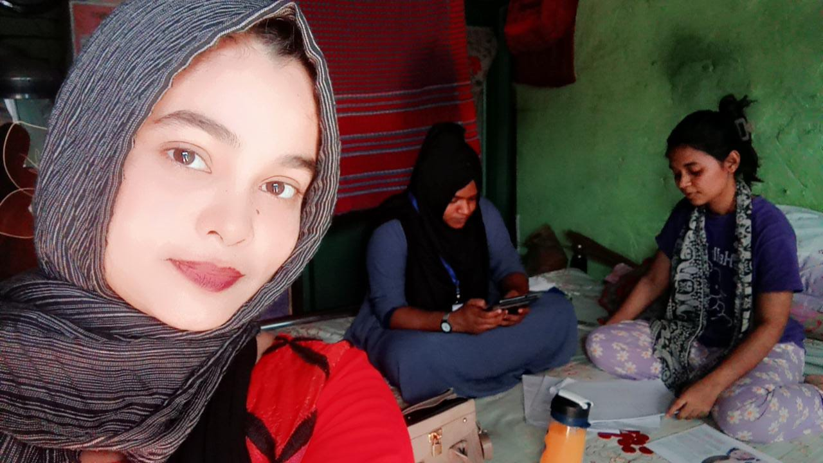
Rin VIP Study
1. Sample size was 825, 434 and 1890 respectively
2. Objective is to launch Rin washing power with its new variants
Surf Excel vs Rin Study
1. Sample size was 828
2. Objective is to development of washing powder
Horlicks Study
1. Sample size was 850 and 350 respectively
2. Objective is to launch new variant of horlicks

Slide 13
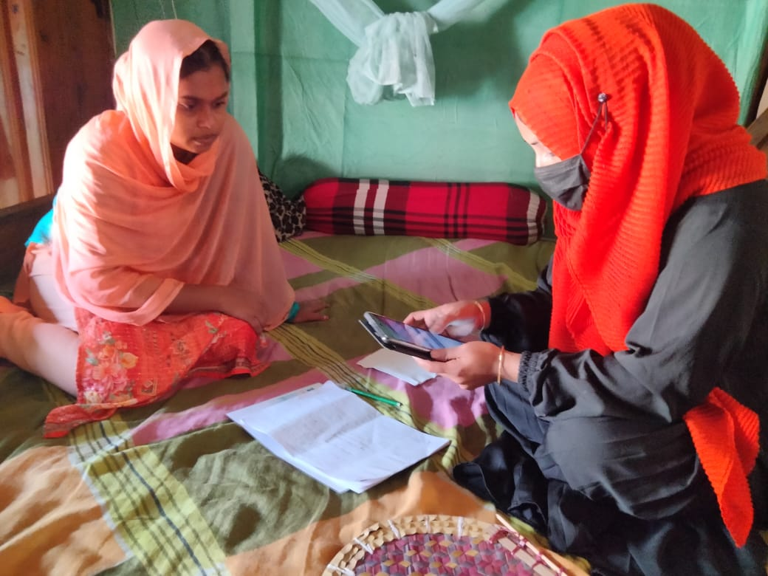
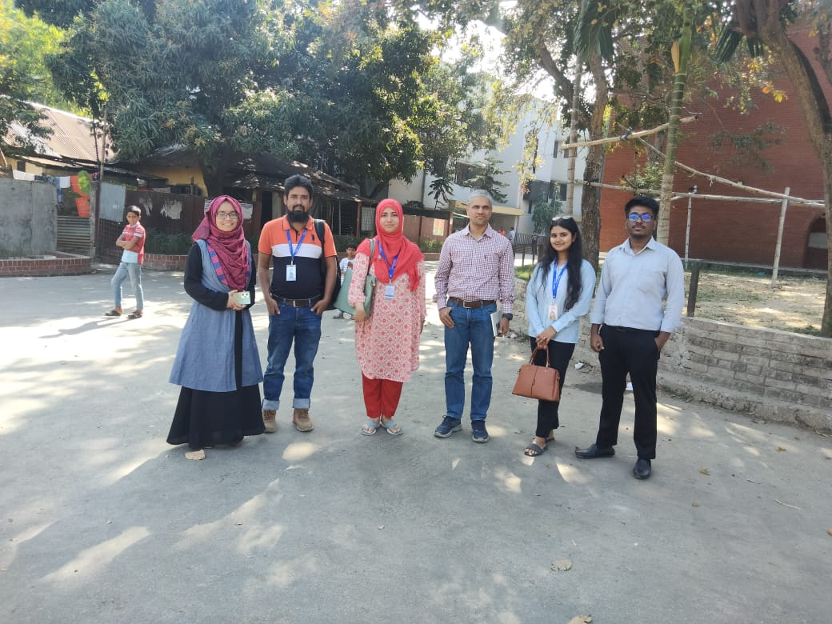
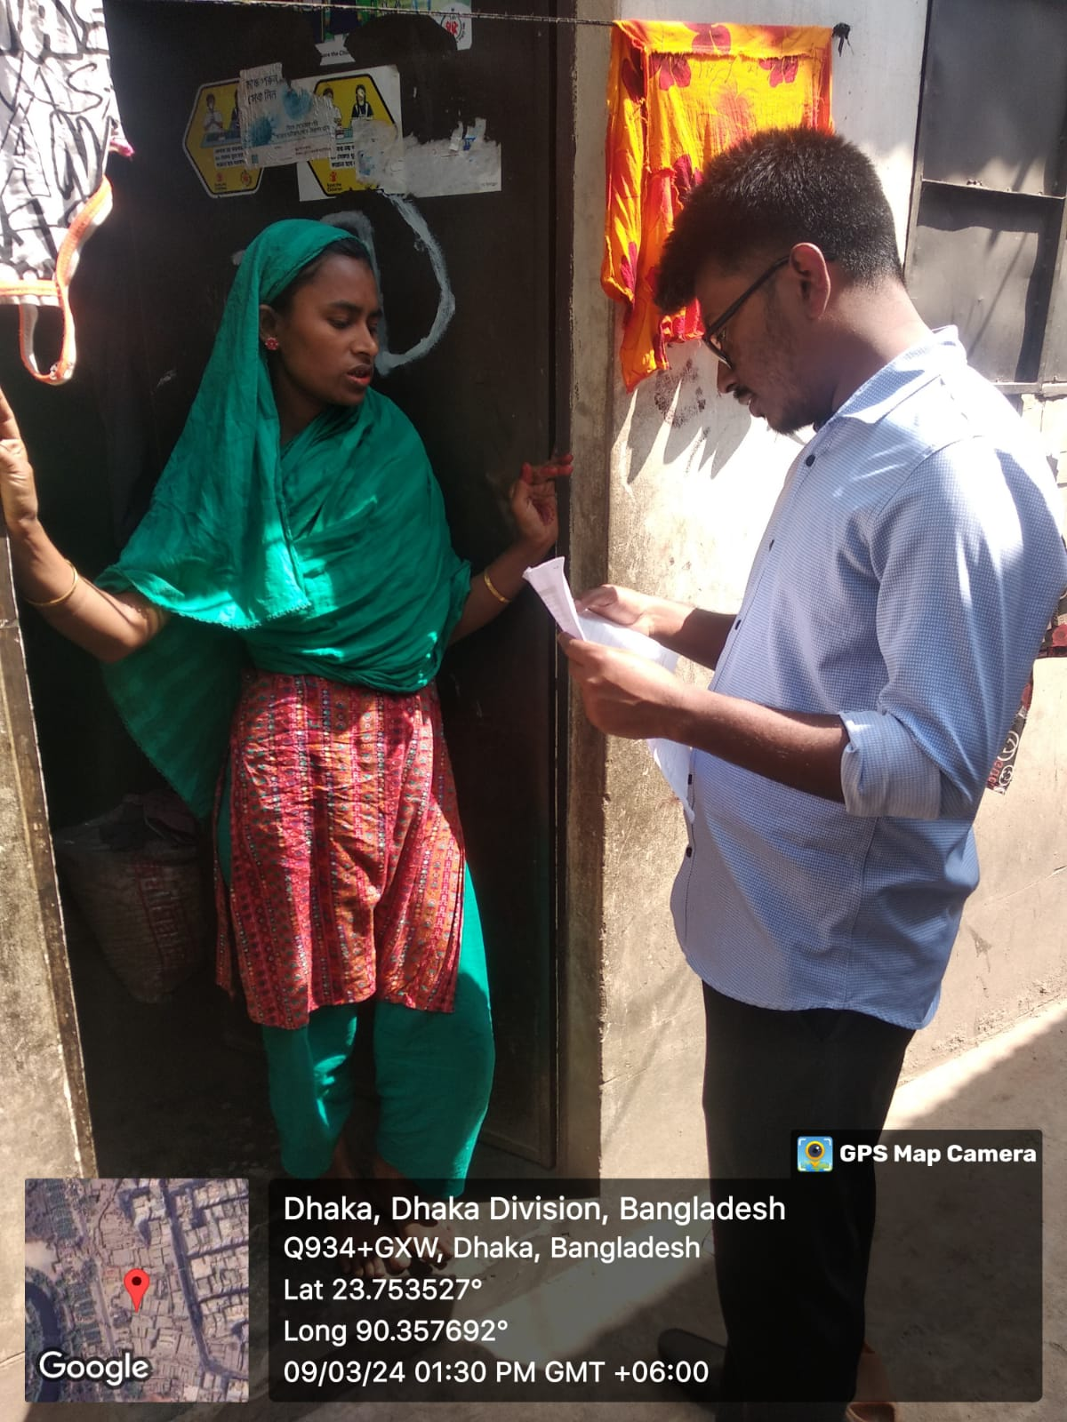
Lux Soft touch Study
1. Sample size 7160 and conducted for two times
2. Objective is to launch new variant of lux pink soap
3. 7 days gap
SS Black Study
1. Sample size was 550 and 572 in terms of conducting 2 times
2. Objective is to development of Sunsilk black shampoo
Taaza Study
1. Conducted for two times- blind test and branded test
2. Objective is to launch new variant of Taaza tea
3. Center was Dhaka, Sylhet and Chittagong

Slide 14
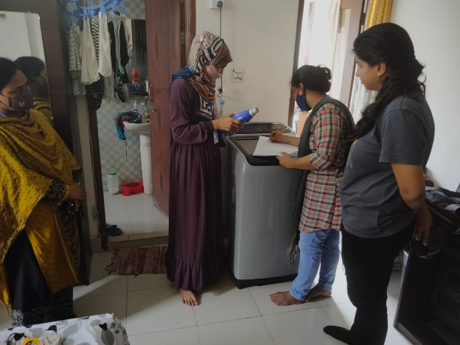
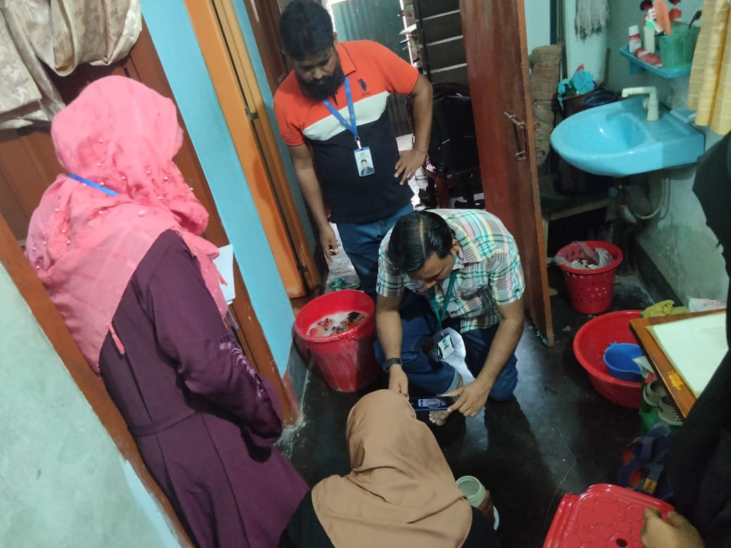
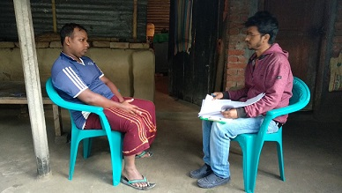
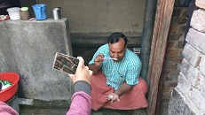
Conducted two times for- Toothpaste and Washing powder
PAPI Method, 820 and 100 Samples
Conducted in Dhaka, Rangpur, Khulna and Rajshahi
TOS (Technical Observation Study)

Slide 15
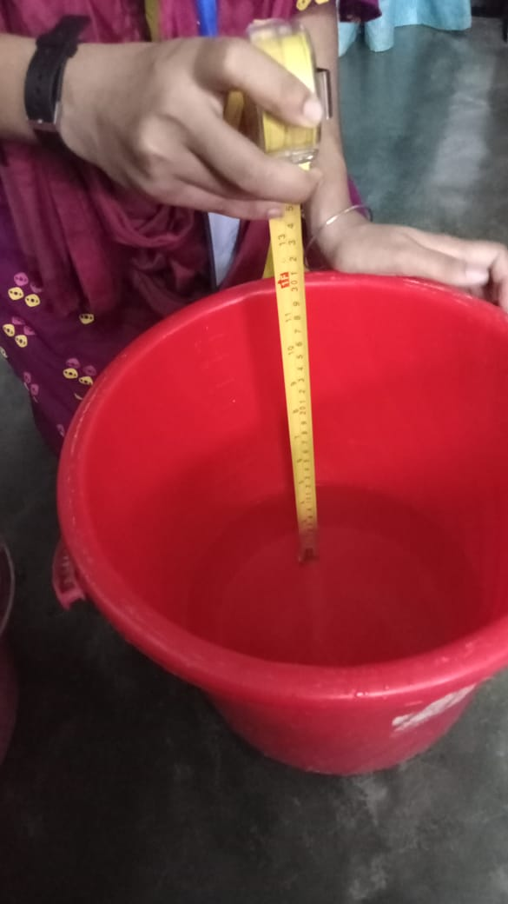
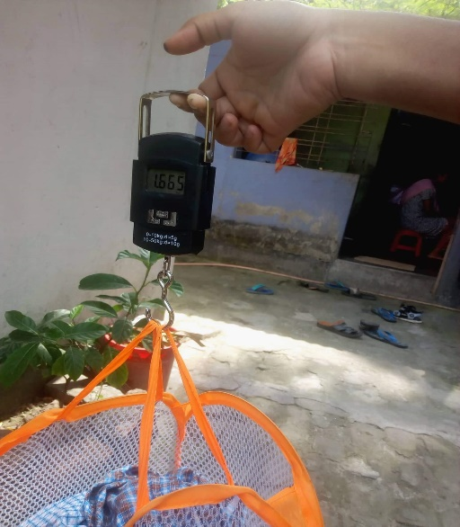
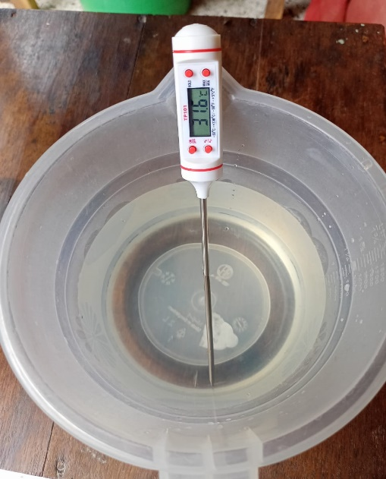
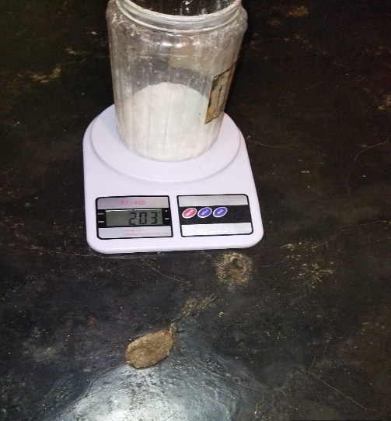
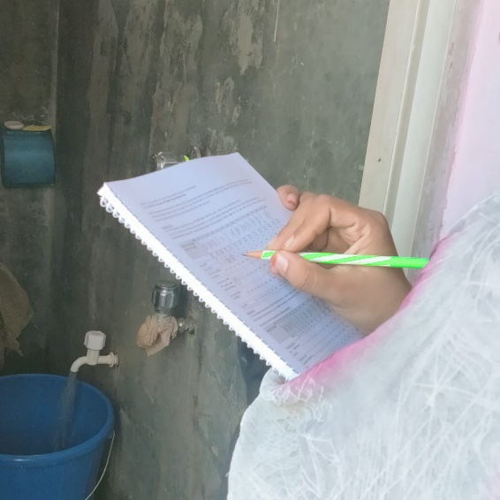
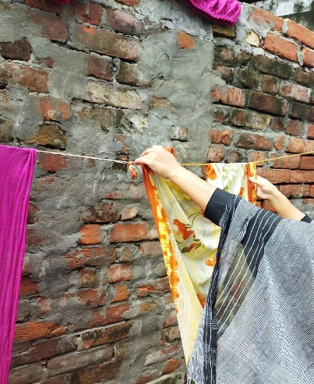
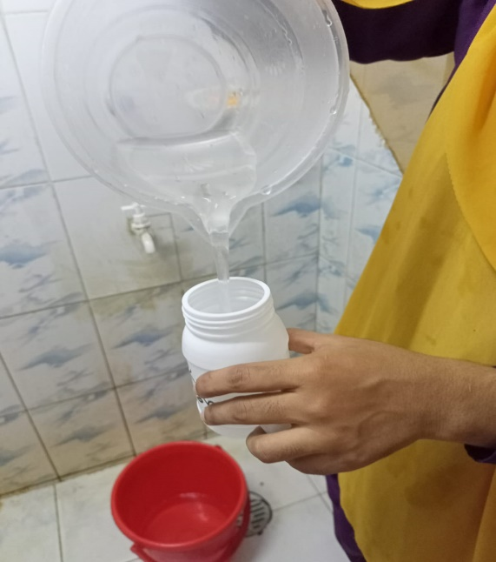
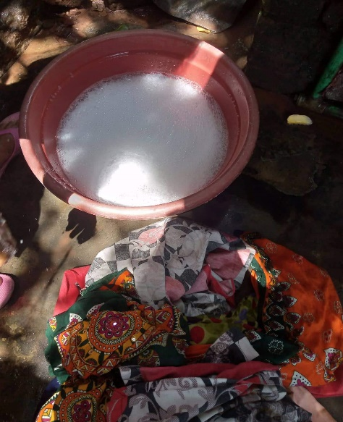
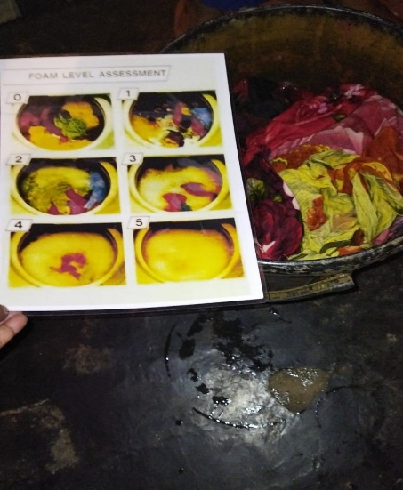
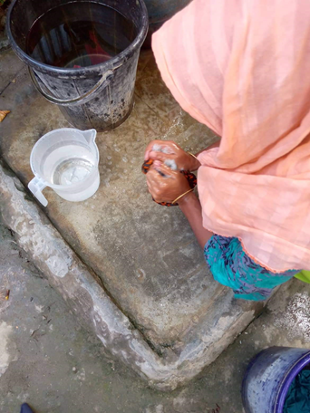

Slide 16
Qualitative Study
Conducted for Hindustan Unilever
Conducted in Dhaka & Chittagong
36 Respondents were recruited
In depth Interview (IDI)
Home Care
Goods

Slide 17
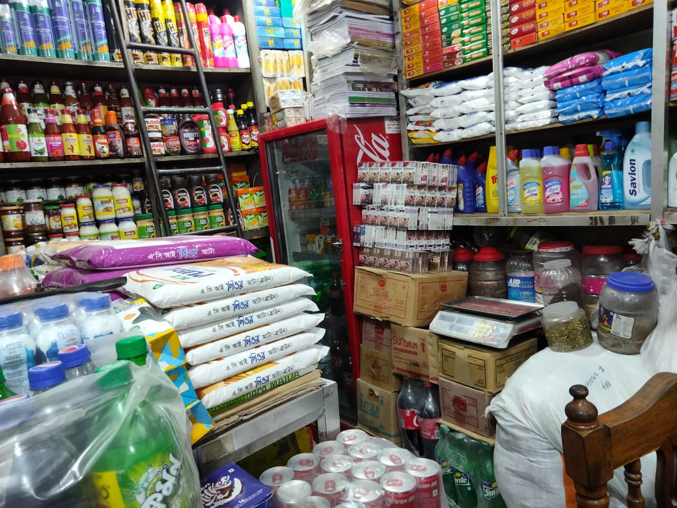
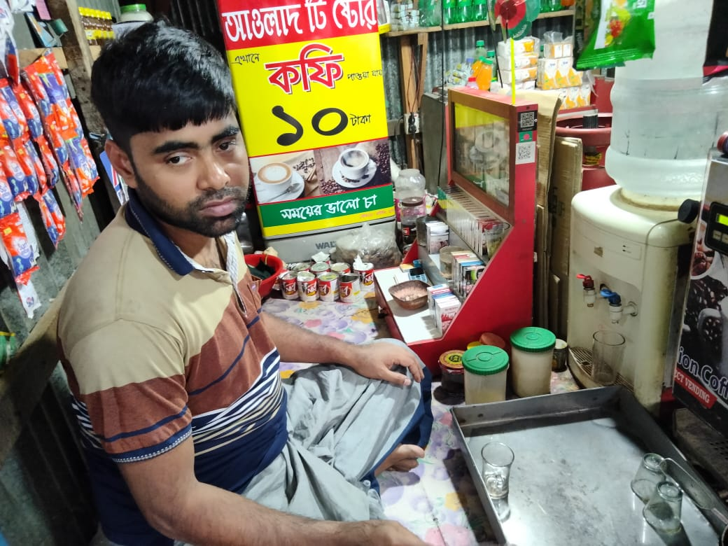
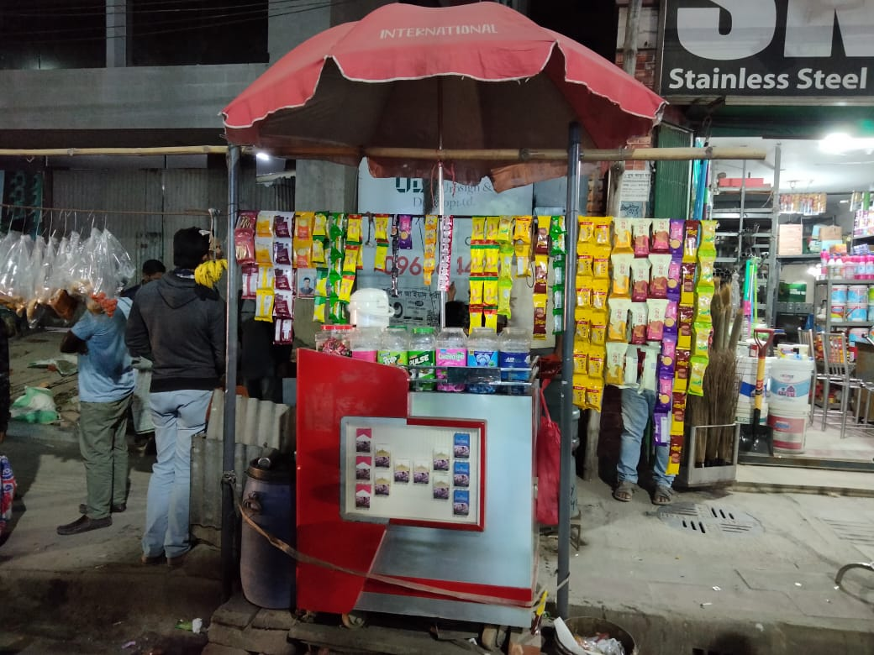
In depth Interview (IDI)
to understand the different factors that influence the investment decisions of the retailers and their preference about some pre-decided investment scenario especially, to capture price change of cigarettes and the changes in selling behaviour, such as becoming non-compliant in selling price.
recruited 6 structured, semi- structured and street kiosks owner/ Proprietor who engaged in cigarette retailing business
online streaming platform like MS Team where client was connected and shared their opinion
Conducted for
British American
Tobacco (BAT)

Slide 18
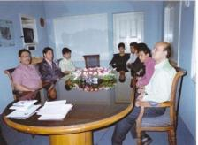
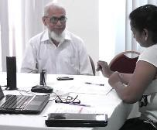
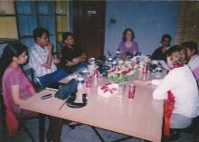
Qualitative Study FGD & IDI
Doctor’s Study
A doctor’s study conducted through several Focus group discussion and depth interview with reputed doctors (pediatrician and general practitioners) on cholera vaccine under the lead agency Net Reactions for Sanofi. The study emphasized on launching a cholera vaccine based on the understanding of status and treatment procedure
Health Study
A study conducted with doctors, pharmacists and patients of Asthma to understand the actual position and status of Asthma as a condition in Bangladesh; also to understand how asthma is treated in Bangladesh along with estimate of the current ‘reach’ of asthma drugs in each city.
Insulin Study
Conducted for British American Tobacco(BAT) based on the customer satisfaction of Insulin

Slide 19
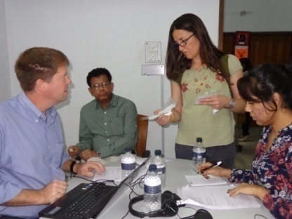
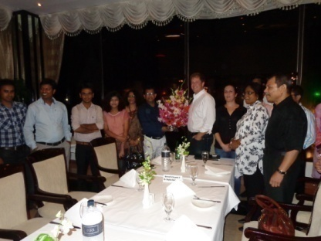
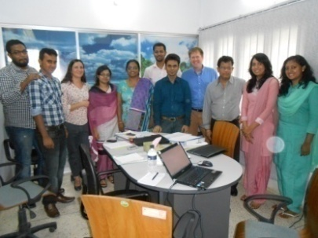
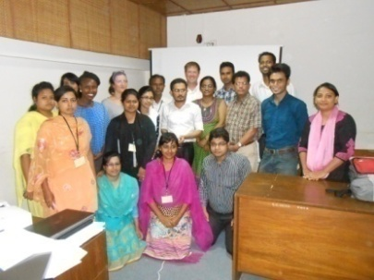
Bill Gates Foundation Health Study : Based on Contraception -CAWI
A Quanti & qualitative study was conducted for IPSOS UK to assess the acceptability of contraceptive methods, opportunities and potential for NOVEL CONTRACEPTIVE PRODUCTS (On-Demand Contraception Methods and Non On-Demand Contraception Methods) among women in Bangladesh, India, Kenya, Nigeria and Senegal.
The study conducted in two phases which are interconnected. The first phase consists of doing pilot survey upon male partners of Women, HCW ’s and Pharmacists where the second phase consists of surveying only women, HCW’s and pharmacists.
The pilot survey with 20 respondents was held at a central venue where respondents were invited based on few screening criteria such as SEC, Age, etc. The main study was conducted over different points of Dhaka, Chittagong, Barisal, Rajshahi with a diversified sample size of 1700 including Women, HCW ’s, Pharmacists.

Slide 20
Concept Test
Conducted for IPSOS Belgium. The objective of this study was to test the concept of five brands of energy drinks.
150 Respondents. The respondents under this study was all heavy, occasional and lapsed users of energy drinks aged 18 to 39. Under this study the main sample size was 100 and booster sample size was 50 respondents.
Computer Aided Web Interview. The study was device aided. This study took place in the urban areas of Dhaka. Both Male and Female were targeted group

Slide 21
Concept Test (Pearl Study)
Conducted for Merico. The objective of this study was to test the concept of Fairness Cream energy drinks.
Sample size was 300, 400, 450 respectively since we conducted the study for several times. The females are the targeted group
The study is took place in Dhaka and Chittagong
The objective of the study is to launch new brands.

Slide 22
Concept Test (Thunder Study)
Conducted for IPSOS India. The objective of this study was to test the concept of energy drinks.
400 Respondents. The respondents under this study was all heavy, occasional and lapsed users of energy drinks aged 18 to 49. This was a purposive study
The study took place in Dhaka and Chittagong
Both Male and Female were targeted group. Young generation was basically the focus of this project

Slide 23
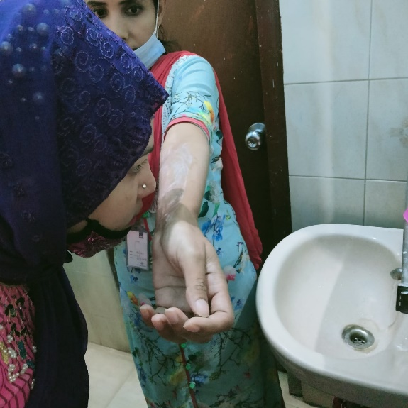
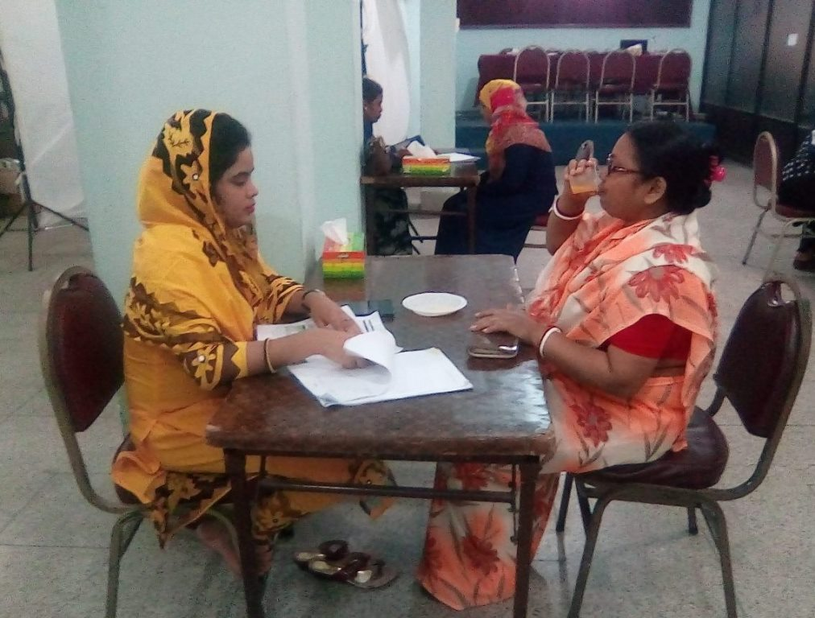
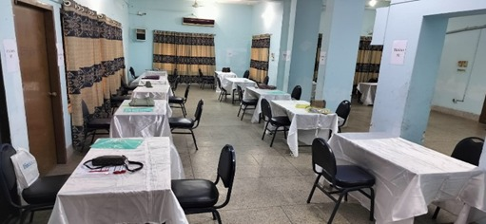
Fragrance Test
1. In home study
2. Sample size 75 and usership was lifebuoy
3. To evaluate the fragrance of 4 soap
Fruit Powder Test (Gulp)
1. Blind drink test
2. Sample size was 450
3. Any kind of fruit powder consumer
Project Suswadu
1. Milk biscuits or cracker consumer
2. Sample size was 300
3. Evaluate test, looks and appearance of milk biscuits
Thunder Study
1. Consumer of electrolyte drinkers
2. To launch a product named “Powarad”
3. Sample size was 400
Central Location Test

Slide 24
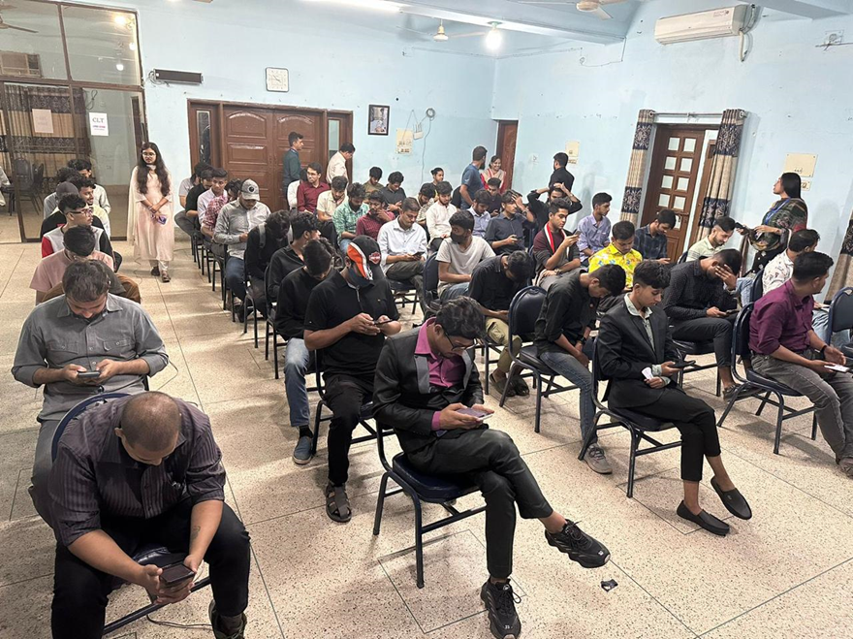
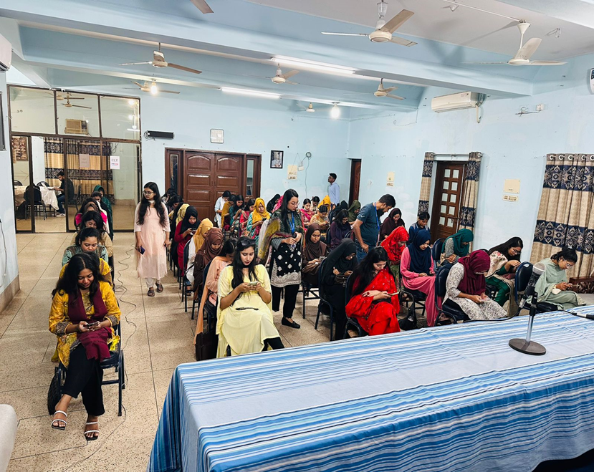
Instant Lab (Cocacola Study)
Instant lab is the systematic module of doing CLT (Center Table) among the required respondent. According to the clients’ requirement, respondent are collected on the basis of attributes like- Age, Gender, SEC (Social Economic Condition) etc.
Objective is to understand the attachment of people with cocacola specially during Ramadan
Computer Aided Interview was done initially and response collected by FGD method
130 respondents were recruited in this study
Both Male and Female participated in this Study

Slide 25
Consumer Satisfaction Study
Huawei
MRS, along with Synovate has successfully conducted customer satisfaction studies for HUAWEI in 2006, 2007 and 2011. The target group of the studies were top and mid level managers and engineers. The objective of Huawei GCSS was to understand the customer needs and demands of Huawei B2B products among different telecom company of Bangladesh. Different methods were applied to conduct this study. For the top level management, data was collected through both CATI and F2F.And for the mid level managers, F2F was applied.
MRS has a successful history of performing numerous Customer Satisfaction Studies for a number of local and global conglomerates. Our notable clientele includes Huawei, Tata, Bajaj, HSBC, Nokia, Sony Erricsson, Walton, Motorola, SHED, Samsung etc.
TATA Motors
1. In order to understand the customer satisfaction level in regard to after sales service and product compatibility, RMI along with TNS global conducted a customer satisfaction study for TATA motors. This study had a sample size of 600 to 1000 which included respondents form all over the country
2. F2F method was applied to collect the data. And the target group of the study were the owners of Tata vehicles and that of competitors like, Hno, Ashok Leykand etc. F2F was applied.

Slide 26
Automative Study (Two Wheeler)
F2F and CLT Method
1. for Acceptance of Hero Ignitor in comparison to the competition set ,
2. uncover current satisfaction areas and features of Hero Ignitor
3. uncover the dissatisfaction areas and features of Ignitor users
4. To evaluate reaction of consumers on overall appeal of design persuasiveness, trial and ease of understanding benefits/option

Slide 27
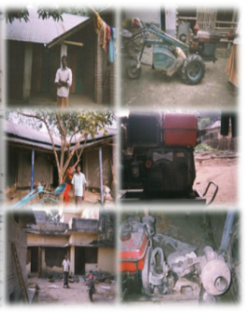
Agricultural Study
12 F2F interviews done in Dhaka, Khulna, Rajshahi & Chittagong to make this study successful.
The study conducted to understand the demand of agricultural equipment used by the large farmers having irrigated land with rice cultivation and quota of rain fed land as well for future business expansion on behalf of Q & Q Research Insights, India, among 12 respondents
Agricultural Equipment Study
Farmers &
Tiller Study
A qualitative study conducted to understand farmer’s farming activities and purchasing behavior to choose Japanese brand HDE (Yanmar and Kubota) / Chinese brand HDE
130 F2F / PAPI interviews done in Dhaka, Khulna, Rajshahi & Chittagong to make this study successful

Slide 28
B2B Study
HSBC
RMI has been conducting trade confidence study for HSBC for many years. In each of the studies, it had a sample of 200 respondents. The target group of this study was the decision makers of Business banking and large corporations. The Business and Trade Confidence Survey runs in 25 markets globally with the aim of better understanding the short term (6 month confidence) of businesses of all sizes.
Bangladesh CSI Study
A qualitative study was conducted to determine the satisfaction among the customers of Bajaj on behalf of Frost & Sullivan among 1130 respondents. 1130 F2F / PAPI were conducted in Dhaka, Khulna, Rajshahi, Chittagong, Dinajpur, Bogra to make this study effective.
Swiped Study
Based on the credit card concept, it was an adhoc study which sample size was 300. Interview was done by F2F method around Dhaka

Slide 29
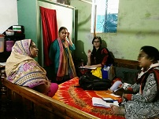
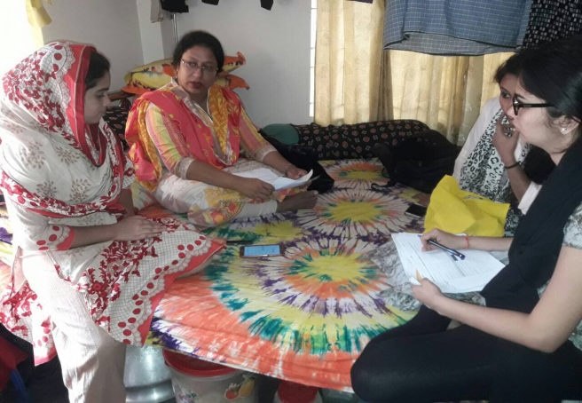
MRS is well equipped in performing in home visits. We have successfully handled numerous projects of this kind. One of which was conducted on behalf of Ipsos India for Unilever among 52 respondents.
The respondents under this study were married women who were the only product purchase decision maker of the household in between the age range of 18 to 49 years of various Social Economic Class (SEC).
In Home Visits
The objective of the study was to test fragrance of detergents and improve the products based on respondent feedback. The respondents were given products to test different options for five days.
After 5 days, the interviewer visited the respondent’s residence for recall interview with clients and interviewed them. The respondents experienced a sniff test during the recall interviews.

Slide 30
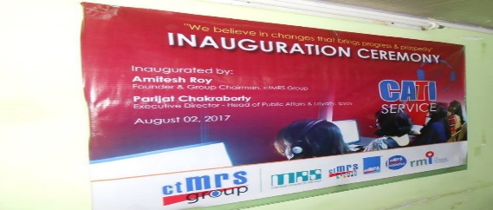
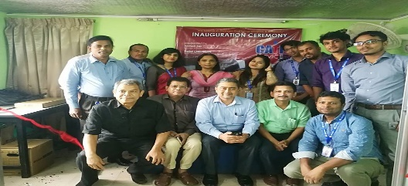
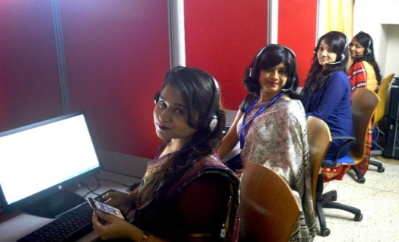
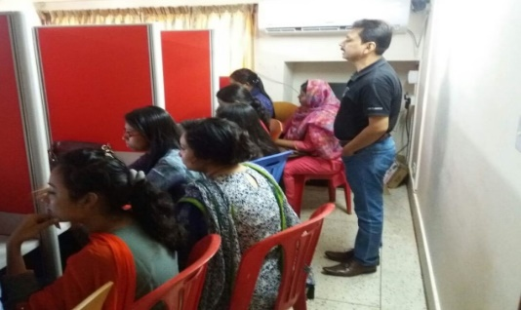
Computer Aided Telephonic Interview (CATI)
Collecting respondents by IPTSP number and internet
30 calling station with predictive dialer
Started from 2017 and last project was done on 2024
On the behalf of VEON using NPS link
About 30 callers do call everyday
Sample size was 4000 in each month

Slide 31
Quality Control Measures
MRS firmly believes that the foundation of a high-quality market research report lies in the collection of reliable data by its field force. This conviction has led MRS to implement stringent quality control measures to ensure the accuracy and integrity of the data collected.
New staffs willing to work on a part / full time basis as a Field Interviewer has to go through a number of tests before induction into MRS . The new comers are then thoroughly oriented with market research interview technique, Do’s and Don’ts of field work by the Authority. After such rigorous screening procedure someone is only allowed to take part in a particular project brief
In briefing session we called those who are selected in prior viva. The duration of briefing is depending on study demand .We use multi-media projector in briefing. After day long brief we do the mock test. We Select those are eligible in mock session .The interviewer needs to gain a specific score in mock test .The mock session is monitoring by Executive team. It’s to remarkable that sometimes we do the Field test before starting the main field work.
One Field Supervisor supervises maximum four to five interviewers to ensure quality of supervision
All types of back check are made within 24-36 hours of the call.

Slide 32
Quality Control Measures
Field Back-Checks
Supervisors, Field Controllers (FC), and Executives-in-Charge (EIC) conduct 25% random checks (AC & BC) at each center. Field Controllers independently verify 5% of the interviews already checked by Field Supervisors and an additional 5% of unchecked questionnaires. For certain projects requiring heightened accuracy, 100% field back-checks are performed by our executive team.
Telephonic Back-Checks
The Quality Control (QC) team conducts 100% telephonic back-checks to confirm respondent eligibility and to verify the duration of interviews, ensuring strict adherence to protocol.
Scrutiny
Field Supervisors scrutinize 100% of the completed questionnaires. Field Controllers further inspect 30% to 40% of both completed and raw forms, while Field Executives or EICs conduct an additional 2% to 5% scrutiny to reinforce data quality and consistency.
Additionally, for specific projects requiring greater authenticity, 5% of interviews are audio-recorded, and these recordings can be provided to clients upon request.

Slide 33
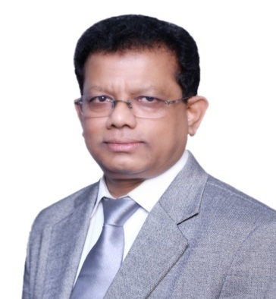
Founder & Group Chairman
A distinguished pioneer in the fields of Event Management, Market Research, and Marketing in Bangladesh, with a professional legacy spanning over 35 years, beginning in the late 1980s.
As the sole founder of ctMRS Group, encompassing five subsidiary concerns—ctMRS Limited, ctMRS Events, ctMRS Logistics, MRS, and RMI—the individual has played a pivotal role in shaping these sectors. The group operates through its primary online platforms, www.ctmrsgroup-bd.com . Prior to establishing ctMRS in 1998, he accumulated 10 years of industry experience at MRC-MODE Ltd., a leading research company in Bangladesh, and MBL Group Plc., a globally renowned research organization.
He also served as the Country Representative for MBL Research Consultancy Group (P) Ltd., India, a subsidiary of MBL Group Plc. (now TNS Global), a globally recognized strategic planning and research consultancy headquartered in London, UK. His tenure in this role provided invaluable insights into international research operations before the launch of ctMRS.
With extensive expertise in Focus Group Discussion (FGD) moderation, he has successfully facilitated over 300 FGDs across diverse consumer segments, including men and women from various socioeconomic classes. His specialization lies in comprehending the unique requirements of high-profile corporations and delivering tailored solutions.
Additionally, he possesses vast experience in executing large-scale events and brand activation campaigns. Notable projects include JPGL brand activities, the JPGL Caravan, Ampfest (an open-air art and music festival by B&H, one of the largest in the country), Paris Comes to Dhaka, Robi Rebranding, and BATB Family Days (2011, 2012, 2013, and 2015), among numerous others, which reflect his profound expertise and successful project portfolio.
AMITESH ROY
Founder & Group Chairman
B. A. (Honors), M.A. in Mass Communication and Journalism
University of Dhaka

Slide 34
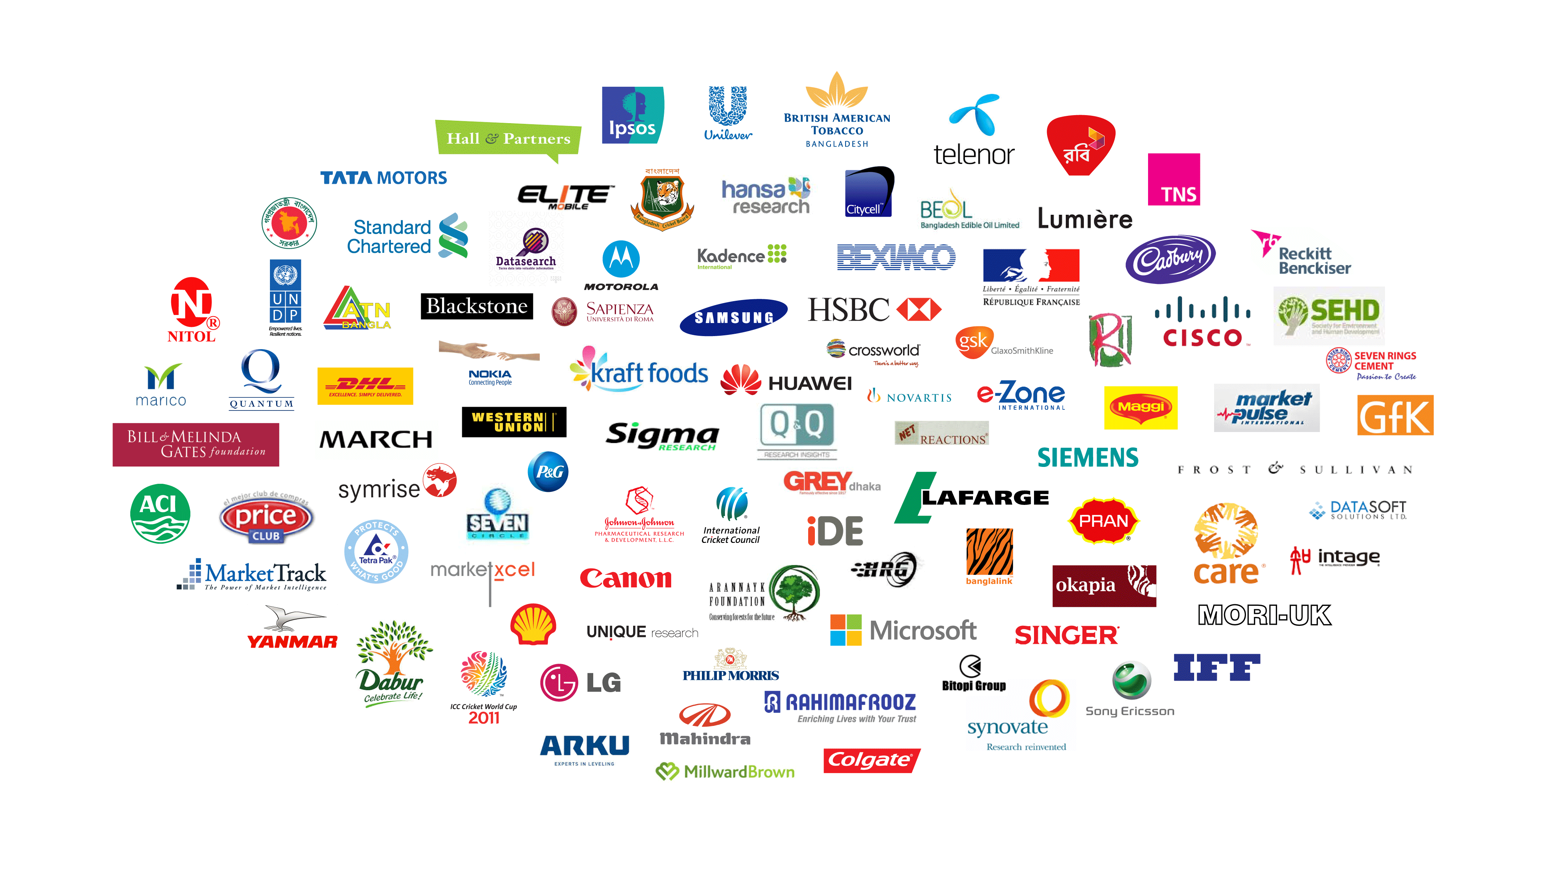
Our Clients

Slide 35

Thank You
Amitesh Roy
Founder & Group Chairman
M : + 88 01709638201
+ 88 01711568431
E : amitesh.ry@ctmrsgroup-bd.com
roy.amitesh@ctmrs-bd.com

